Slide 1
Technology in Medicine
The History and Importance

Slide 2
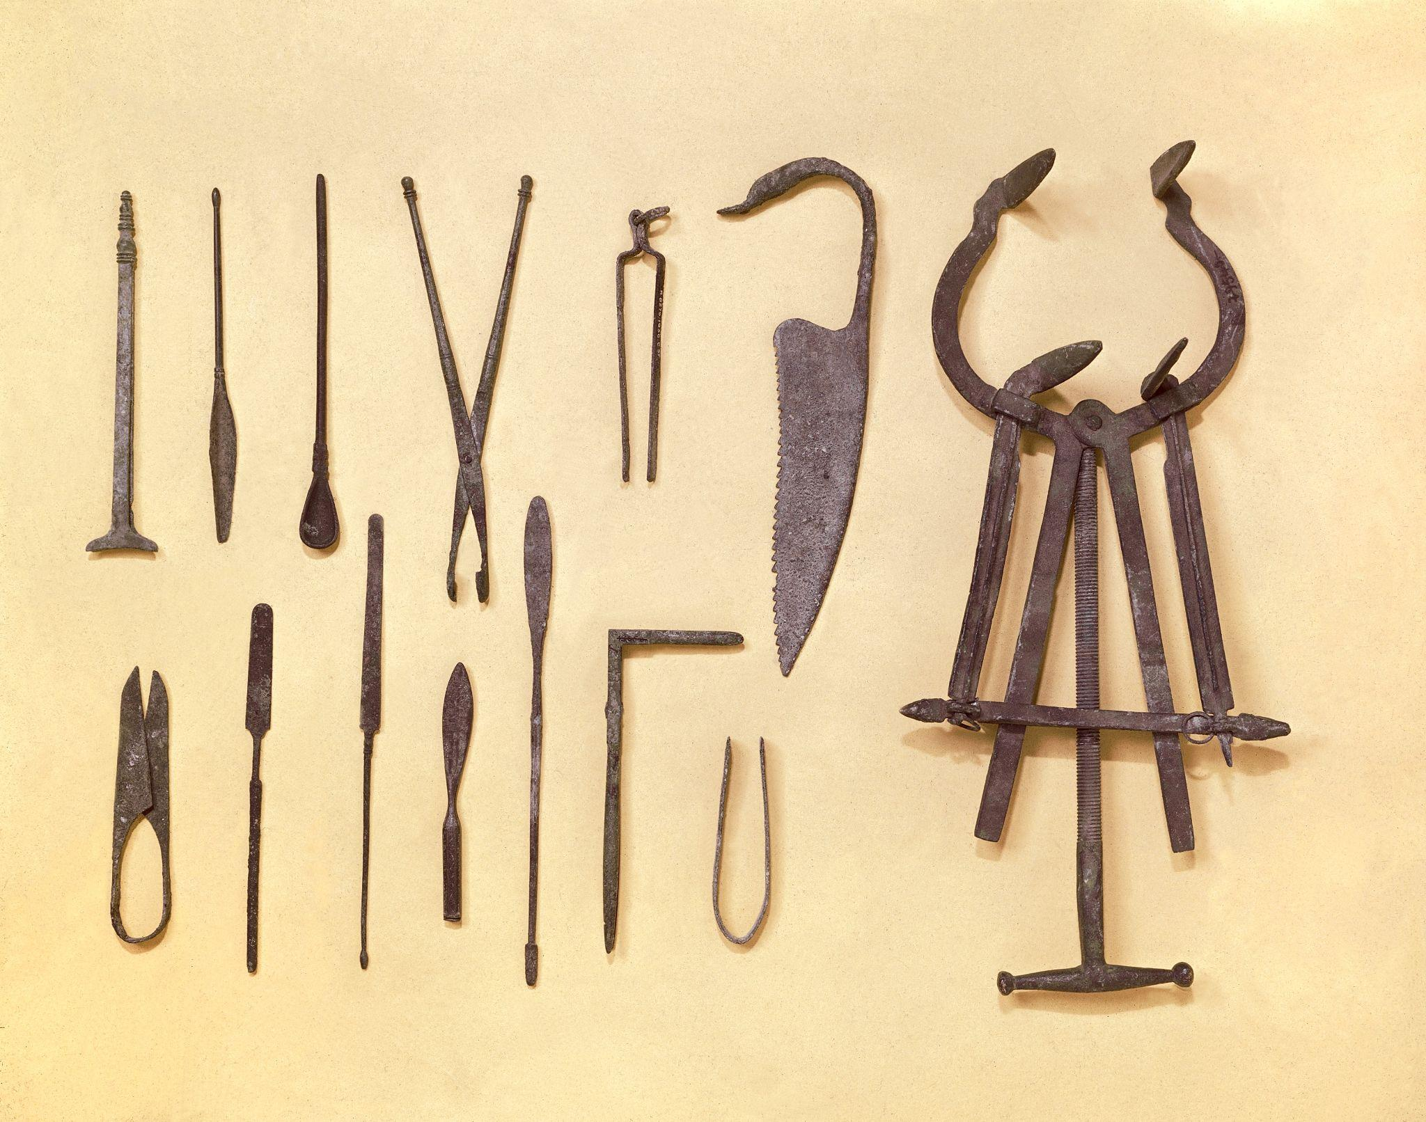
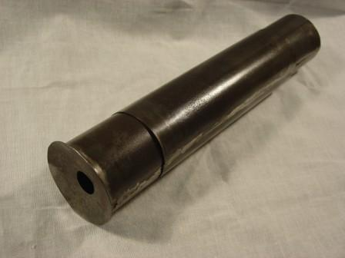
Early Medical History
Some of the earliest medical technology has been recorded since the BCE to the 1500s.
This includes:
Prosthetic devices made of wood and leather in 950 BCE.
Surgical equipment that set the patterns of the modern ones between 300-500 CE.
The invention of spectacles in 1268
The invention of the compound microscope in 1590.

Slide 3
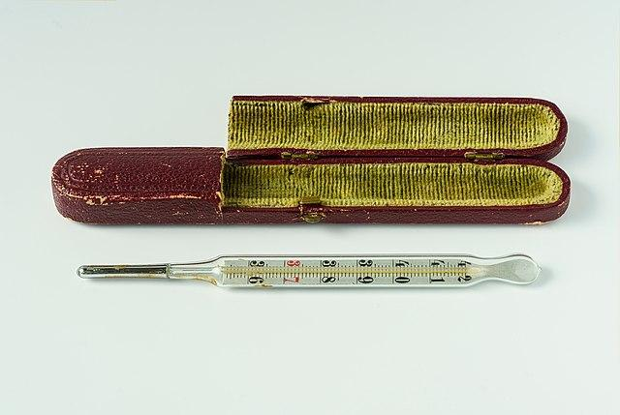
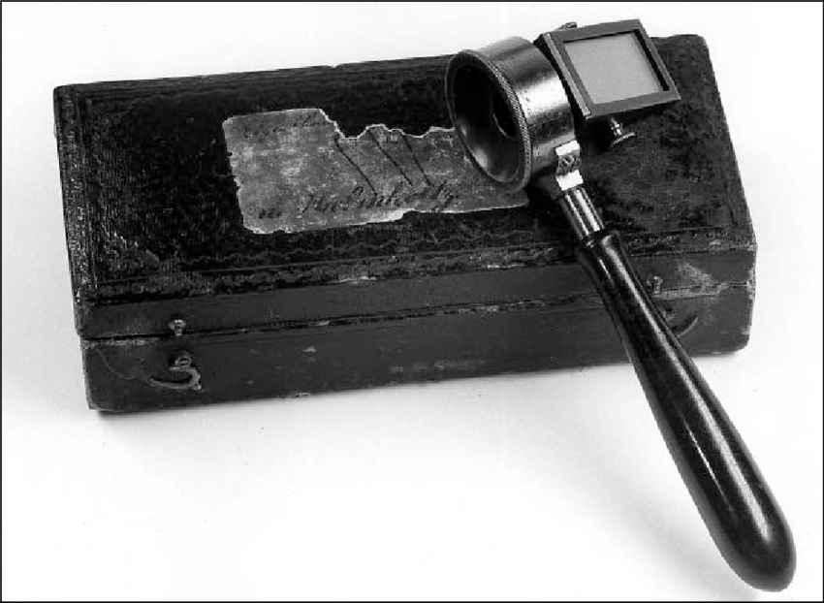
Medical History
In 1714, Daniel Gabriel Fahrenheit invented the mercury thermometer.
In 1816, a french physician invented the stethoscope.
It originally a trumpet-shaped tube.
The ophthalmoscope was invented by a German physicist and physician in 1851.
Tool used to to examine the retina and other parts of the interior of the eye

Slide 4
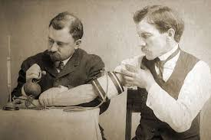
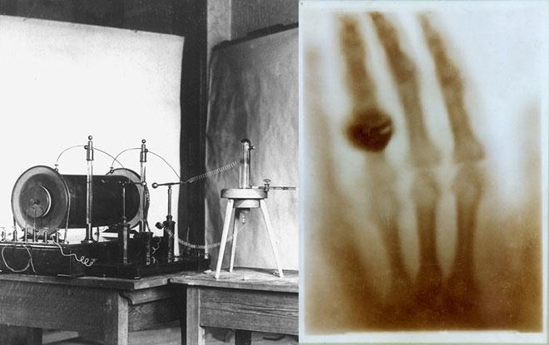
Medical History
The sphygmomanometer, also known as a blood pressure monitor, was invented in 1881 and popularized in 1901.
In 1885, the first electrocardiograph machine was developed.
In 1895, the first X-rays were discovered and published.
The first cancer treatment, radiation therapy, was used in 1899.

Slide 5
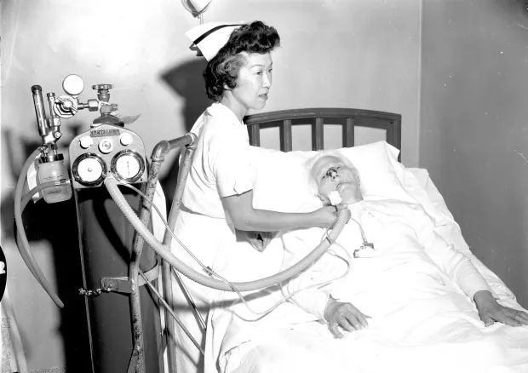
Technology in Medicine
Medical technological advancements in the past 50 years have vastly changed the practice of medicine.
It has also improved quality of life and increased life expectancy.
In the 1960s, the discovery of medical technology increased alongside the quality of care and the longevity and quality of life.

Slide 6
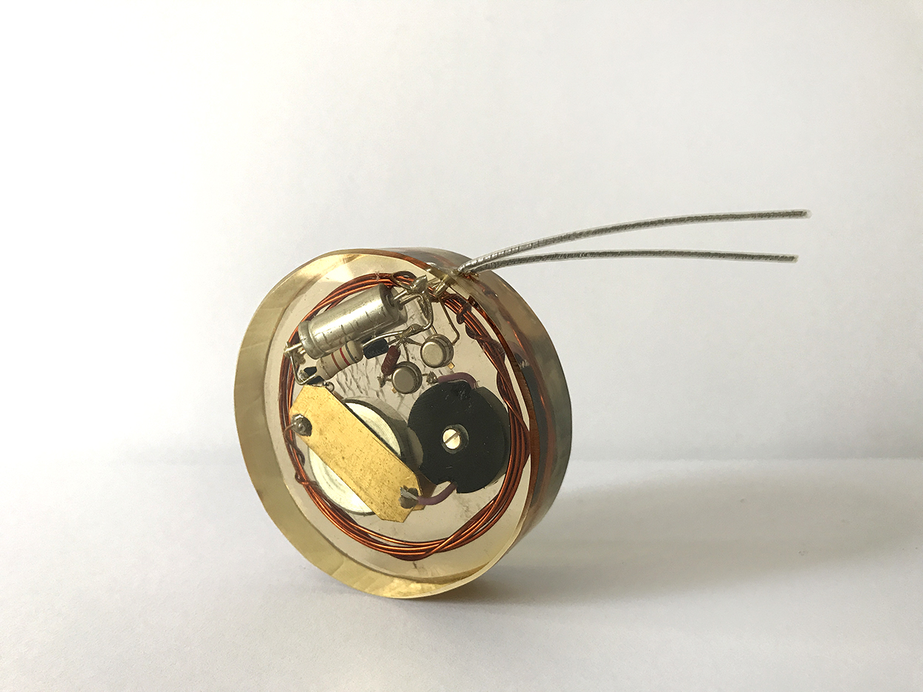
Technology in Medicine
The first internal pacemaker was developed and implanted in 1960 by Wilson Greatbatch.
In 1960, Theodore H. Maiman was the first to operate the first optical laser.
Lasers are used in many ways in medicine, such as surgery and kidney stone treatment.
The portable glucose monitor was invented in 1969.
Allowing patients with diabetes to have a healthier and better quality of life

Slide 7
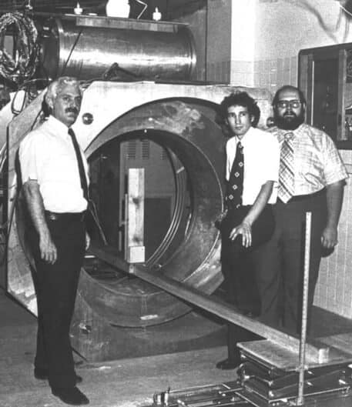
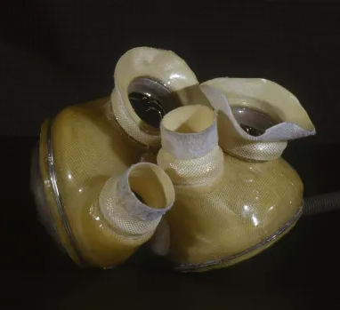
Technology in Medicine
Computer technology merges with medical technology in the 1970s.
In 1974, Raymond Damadian discovers how to use magnetic resonance imaging (MRI) for medical diagnosis.
In 1982, the first permanent artificial heart was implanted.
The artificial heart was implanted into Barney Clark, who survives for 112 days.

Slide 8
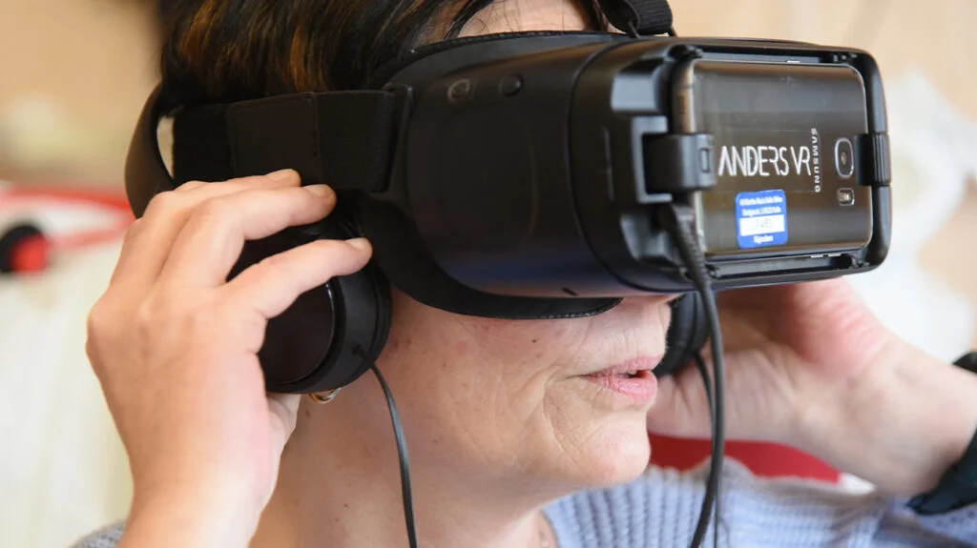
Recent Medical Technology
The use of virtual reality in the medical field.
Psychologists can use VR to treat psychological disorders, such as anxiety.
3D printing has become beneficial in medicine when it comes to prosthetics and implants.

Slide 9
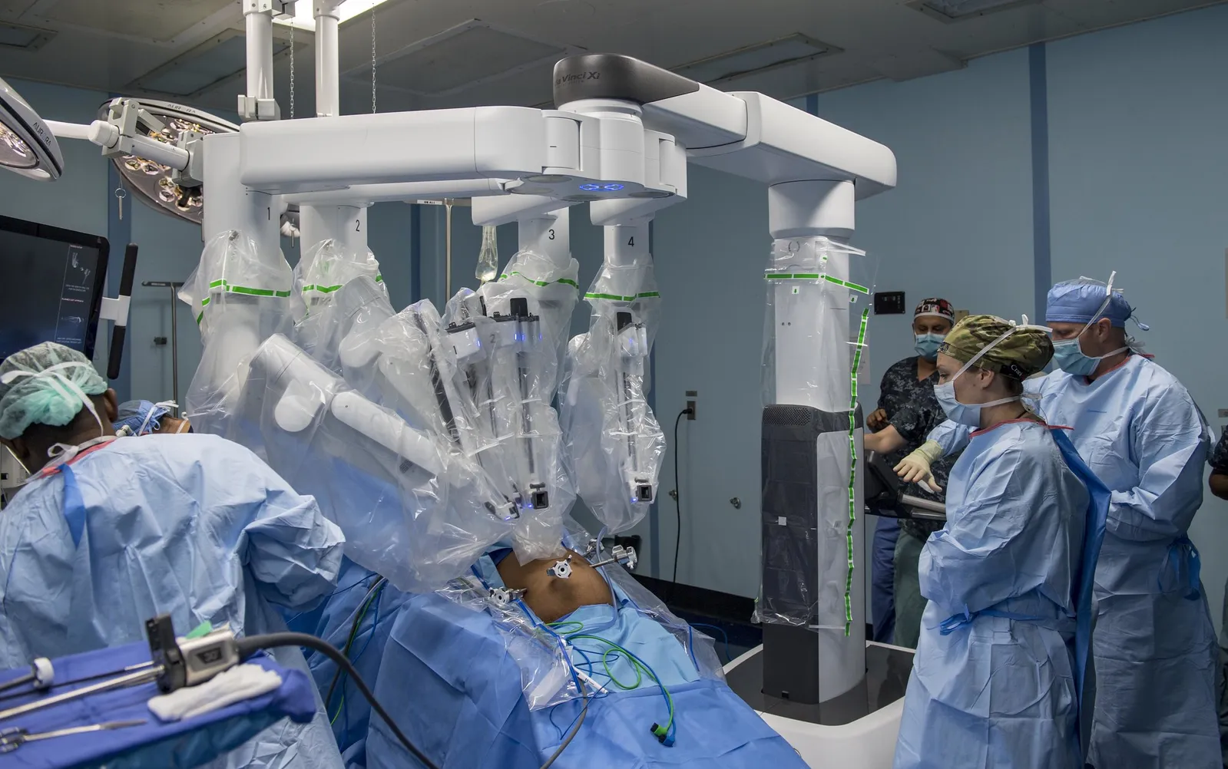
Recent Medical Technology
Clustered Regularly Interspaced Short Palindromic Repeat (CRISPR)
Technology that allows professionals to edit the genes of patients.
Can be used in the prevention and treatment of diseases, cancer, and genetic disorders.
Robotics in healthcare
This technology has help medical professionals during surgeries.
Instead of a doctor performing surgery directly, they are operating through a robot.
This allows for more precise control and less chance for contamination in the operating room.

Slide 10
Importance of Medical Technology
Medical technology refers to the devices, resources, and systems medical professionals use to diagnose, understand, and treat patients.
There are five distinct areas of technology in the industry.
These areas all play a role in supporting healthcare professionals as well as patients.

Slide 11
Importance of Medical Technology
The five areas include:
Prevention
Technology that helps the public prevent illnesses and injuries.
Diagnosis
Technology that help medical professionals diagnose illnesses and injuries.
Monitoring
Technology that assist in monitoring existing health issues and has the ability to alert a patient or healthcare professional about an important change in the condition.
Treatment
Technology that provide aid in the treatment of illnesses and injuries.
Care
Technology that helps individuals recover faster following medical procedures or long-term illnesses.

Slide 12
References
12 medical technologies you need to know about in the medical field. Concorde Career College. (n.d.). https://www.concorde.edu/blog/12-medical-technologies-medical-field
Geffen, D. (2023, June 22). Medical advances in technology: UCLA Med School. UCLA Medical School. https://medschool.ucla.edu/blog-post/medical-advances-in-technology-of-the-past-50-years
Medical devices timeline. Morgridge Institute for Research. (2020, January 6). https://morgridge.org/community/teaching-learning/medical-devices/medical-devices-timeline/
Yale School of Medicine. (2019, July 1). Medical Devices and technology across the years. Yale School of Medicine. https://medicine.yale.edu/news/yale-medicine-magazine/article/medical-devices-and-technology-across-the-years/

